Slide 1

Automated answer sheet evaluation.
Department of Artificial Intelligence & Machine Learning Mini-Project Presentation – Review 2
Team Members:
Harshavardhan MG (1GA22AI015)
P Praveen Raj (1GA22AI031)
Project Guide:
Prof .Vani
Designation:
Assistant. Professor

Slide 2

Status of the Project:
Application : Frontend and Backend implementation using
React.js as Frontend
node.js as backend
mysql as database
Evaluation model : Successfully implemented vision-model to extract
the content from the Answer Sheet.

Slide 3
About the Project:
Problem statement : “Grading answer sheets is a time-consuming and labor-intensive process. There can be an automated system that can provide consistent, accurate results reducing the grading workload.”
Objectives :
1)To build a model that can accurately and efficiently evaluate the
answer sheets (descriptive answers and diagrams).
2)To implement the model using application.

Slide 4
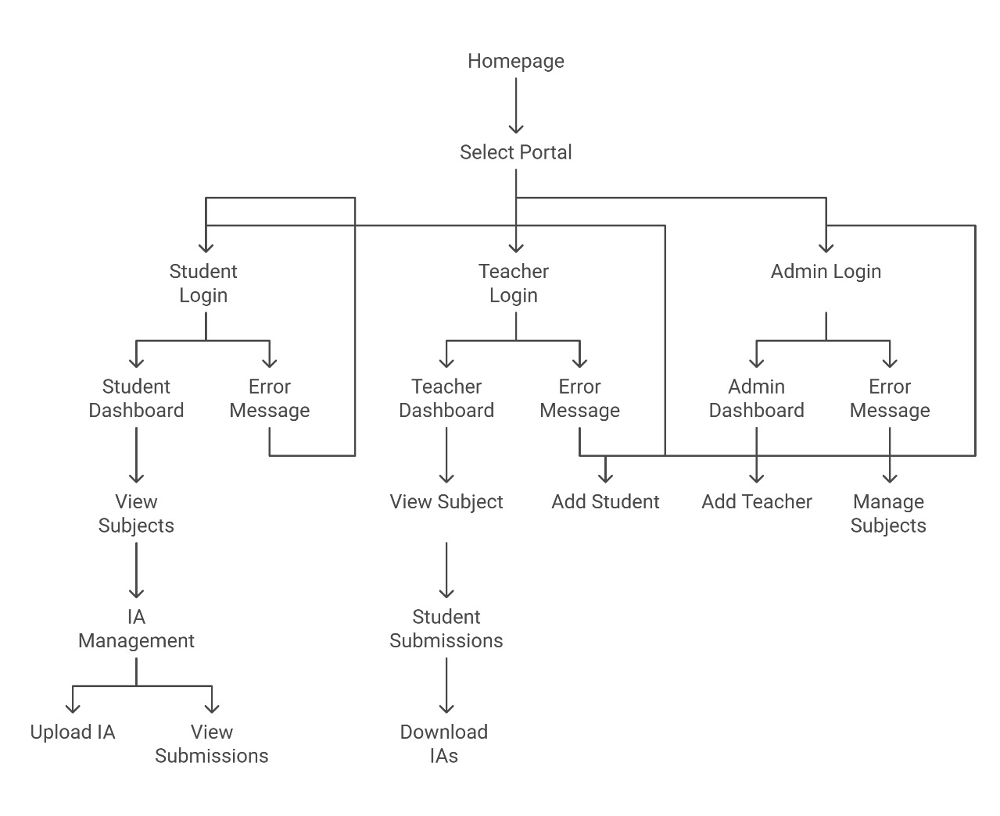
Application Architecture:

Slide 5
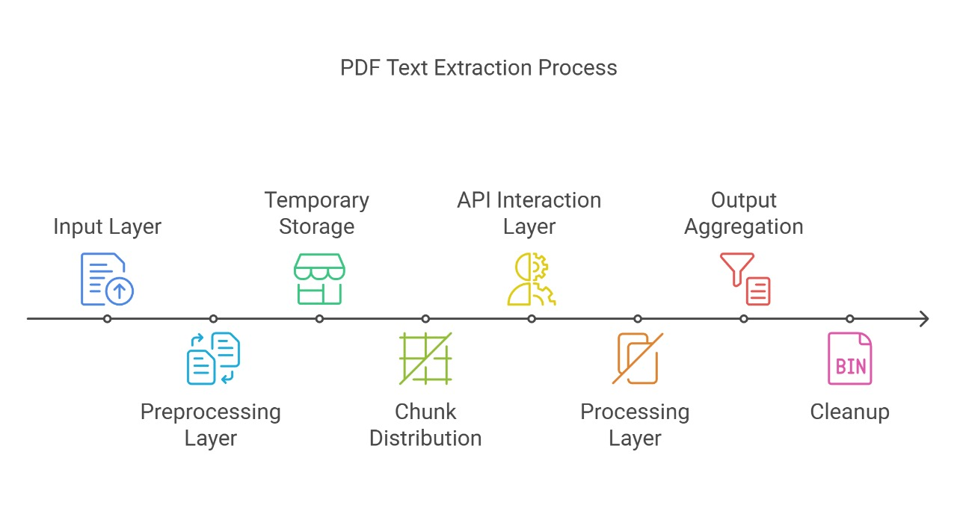
Model Architecture:

Slide 6
Phases of project implementation:
Building a model to accurately extract the content and diagrams from the answer sheet and the reference solution.
Building a model to compare the extracted content with the reference solution.
Grade the answer sheet consistently.
Provide Insights on where the student can improve.
Implementing the model in an application for ease of use and structured implementation.
Receiving feedback from Educators for further fine-tuning.

Slide 7
Proposed model and Working Criteria:
Proposed Model:
Vision Models : Locally run models or Implementing Online models
using api’s.
Application : Application built using React.js , Node.js and mysql.

Slide 8
Progress Achieved:
Completions:
50% of the project done.
Implemented the model to Extract the contents of the Answer sheets.
Challenges:
Improve the time taken to extract the content.

Slide 9
Future Implementations:
Grading model
Integration of the model with the Application

